Slide 1

TECHNOLOGY RECOMMENDATION
(Akaike Tech)
-By Mohit Bagaria

Slide 2

Objective
Which technology, a company might adopt or require soon?
Based on the past usage of Technologies they have used in the past.

Slide 3

The solution
-Data Collection
-Data Pre-processing
-Model Training
-Recommendation

Slide 4
Data
Pre-processing
Filtering data
Bloom Filter
Splitting Data
Company, Technology, Sub-category, Last-Used On
Total Companies: 12410952
Total Technologies: 28375
Date - 08-06-20 -10-02-21
Connection Density - b/w Company & Subcategory - 0.015
Separate data for mapping of technology to its category and subcategory.

Slide 5
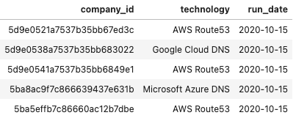
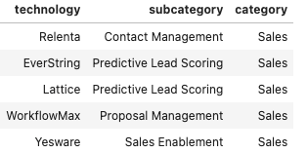
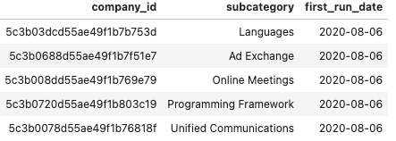
By joining the above 2 tables we create a new table that maps a company to a subcategory.
And the min of run-date of the company-subcategory pair gives us the first date on which the company-subcategory pair was detected
The table beside gives us the training data that we can use to start training the model.

Slide 6
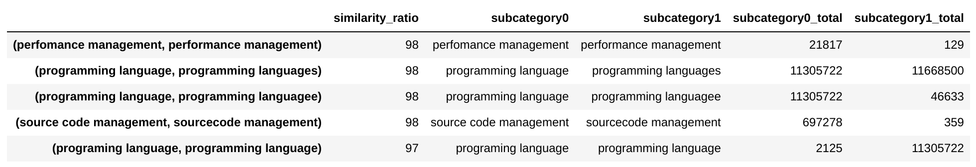
Filtering Data
Same subcategories have spelling mistakes or differ in space or punctuations
Clubbed the similar categories using Fuzzywuzzy library

Slide 7
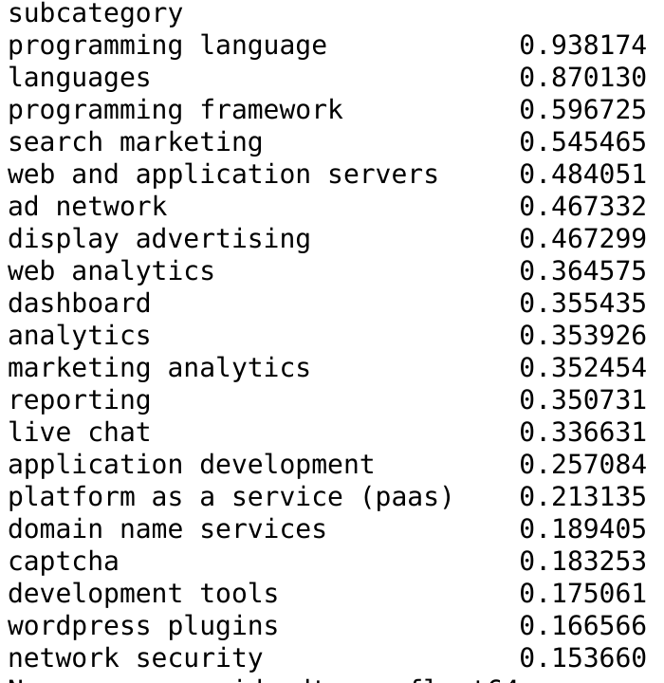
Removed common Subcategories
Removed subcategories like Programming Language, Programming framework & web and application servers which are common to most companies
On an avg, a company is using 10 subcategories

Slide 8
Preprocessing steps
Vocab with all imp features (company id, subcategory,city, state, size, sector)
Removed companies with few subcategories (<3 for now)
1 |  | 2 |  |  | 3 |  |  |  | 4
Bloom filter to check if company subcategory pair exists
Removed subcategories used by very few companies (<100)

Slide 9
Model Building
Model
Pair
Creating Vocab
Collaborative-based deep learning model to come up with the predictions.
98.5% chance that a random pair of companies and subcategories won’t be connected
A dictionary having all required entries

Slide 10

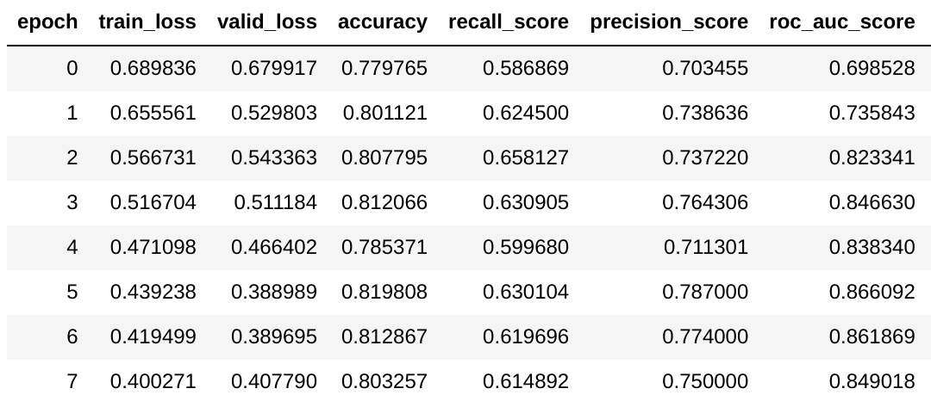
Accuracy

Slide 11
Any Questions?

